Slide 1
Apica
Professional Services
Apica Introduction Stockholm 20-24/2, 2017
Patrick Moser

Slide 2

Agenda
Organisation
Roles & levels
Career path
Basic tasks
Strategy & purpose
Going global
Service catalogue
Competence plan/matrix/mapping
Best practices
Tools & support systems
DevOps & QA partners
Focus areas in 2017

Slide 3

Who am I?
Name: Patrick Moser
Joined Apica a year ago in January, 2016
Head of Apica Professional Services Organization
Age: 52; Married, 2 daughters
On my free time: runner, photographer and chess player
Education: BA in Computer Science
Work experience: 30 years in IT, SDLC and consultancy services
20 years experience with Test & QA
Work experience from multi international companies:
Ericsson (Telecom), Sybase (DB), Mercury Interactive (Test), SQS (Test & QA consultancy)
Part of a startup company - Validate
2004-2008 (staff growth from 3 to 70)
Company sold after only 4 years to SQS

Slide 4











PS – Organisation (SE)
Some bullets about PS…
Staff growth
Growth by 7 people in 2016
Roles within PS
Performance Engineers (67%)
Test Leads (25%)
Number of projects
85+ projects delivered YTD (Load test & Synthetic monitoring)
Peak periods
Peak periods are May-June & Oct-Nov
Utilization rate
Average of 75%
Low utliization in january 2016 & 2017
Average age
37,5 years old
Thomas Wiik (Principal PE)
Abdiqani Hassan (Senior PE)
Carl Ericsson (PE)
Johan Torneheim (Senior PE (Test lead)
Henrik Caesar (Senior PE/Test lead)
Per Andersson (PE)
Mikael Thinsz (Test lead)
Fredrik Söderbaum (PE)
Niclas Tollgård (IT Architect)
Stefan Johnson (Senior TL/Agile Coach)
Johnny Huhtala (Junior PE)
Patrick Moser (PS Manager)

Slide 5






PS – Organisation (US)
Ervin Talactac (Senior PE)
Mark Gilbert (Senior PE)
Daniel Bengtsson (Senior PE)
Duncan Essex (PE)
Robert Karaszi (PS Manager)

Slide 6

PS - Roles & levels
Roles
Performance Engineer (PE)
Test Lead (TL)
Skill levels
Junior
“Standard”
Senior
Principal
Expert
“Other technical roles” (part of Sales Organisation)
Solution Engineer (SE) (pre sales)
Technical Account Manager (TAM) (post sales)
PS collaborates with both SE and TAM

Slide 7
PS – Career path
Tools Comparison/s
Tools Integration/s
Test environment/s
Infrastructure/s
Test data management
Test security
Capacity Planning
Continues Delivery
Performance Test Center (CoE)
KPI management
Dashboard management
Test Environment management
Methodology & Process management
Tools management
Knowledge & information evangelist
Current situation analysis
Test Improvement
Strategy
Expert PE
Solution
Architect
Expert TL
Test/QA
Manager
Advanced scripting (plugins, inline)
Advanced Analysis
APM expertise
Data restoration
Tailored training
Trouble shooting
Risk assessment
Test Implementation
Test strategy
Resource management
Requirement analysis
Test design, test case / scenario management
Principal PE
Principal TL
Senior PE
Senior (TL)
Scriptning Services
(LT & Synthetic Bundles)
Setup & Execute LT
LT Scenarios & Analysis
LT Recommendations
Training delivery
Test Management (off site)
Project scoping
Project onboarding
Review LT reports
Project evaluations
Performance Engineer (PE)
Test Lead
(TL)
Apica – Services

Slide 8

PS - Basic tasks
Project deliveries
Load Test (ALT)
Synthetic Monitoring (ASM)
Sweden/Nordic
RoW (UK) (occasionally)
US (seldom)
Education
External training
External workshops
Marketing
Conferences
Customer events
Presales tasks
Supporting sales
Supporting partners
Support tasks
2nd line support
Advanced scripting
Internal PS development
Best practices
Templates and utils etc
Knowledge sharing

Slide 9

PS - Strategy & purpose
Engage with customers to deliver superior quality services
Happy customer remains with Apica and buys more (upsell)!
We deliver services around our core product solutions ALT and ASM
Scoping, Planning, Scripting, Executing, Analyzing, Reporting
Deliver training and transfer of skills to customers and partners
Deliver often short engagements (LTFS)
Supports continuously our recurring license customers (LTSaaS & ASM)
Deliver also extended services
Expert level consultancy / strategic advisory
Solution Architect
Test & QA management

Slide 10

PS - Going global…
Global Competence Plan
Global Competence Matrix
Global Staff Development Plan
Global Staff Rotation Program
Global Recruitment Plan
Global Induction Program
Global Best Practices / Implementation Methodology
Global Extended Services Plan
Global Training Program

Slide 11

Apica - Service catalogue
LT & ASM – Performance test strategy
Agnostic LT performance test strategy
LT performance implementation strategy
ASM implementation strategy (TAM driven)
Apica performance solution strategy (LT and ASM combined)
LT & ASM – Methodology support
LT SaaS – Best Practises
ASM – Best Practises (TAM driven)
LT - Continuous integration / delivery
LT - APM Integration / Managed services
ASM – Analysis & Reporting services
ASM – Integration services (CDN, Google, Dashboard, Alarm, Custom integration, …)
ASM – DNS Services
LT – Performance center-of-excellence (CoE)
LT - Environment & Test data management
LT – Security (DDOS, Penetration tests)

Slide 12

PS - Competence matrix
PS Competence Matrix (Smartsheet)

Slide 13

Competence areas
Our solutions
Apica Load Test (ALT)
ZebraTester (Scripting tool)
Load Test Portal (LTP) (Load Test Platform)
Apica Synthetic Monitoring (ASM)
Application Performance Monitoring (APM)
AppDynamics, Dynatrace, NewRelic, Instana
Competitors, collaboration & integration tools
Load Testing
Microsoft (Visual Studio), Gatling, HP (LoadRunner), Soasta, JMeter
Syntethic Monitoring
Splunk, Elastic stack, Graphana
Build Tools
Jenkins, Teamcity, Bamboo, AWS Code pipeline
Other
Integrations, Streaming, Security (DDOS), Mega tests (LT), DNS, CDN

Slide 14
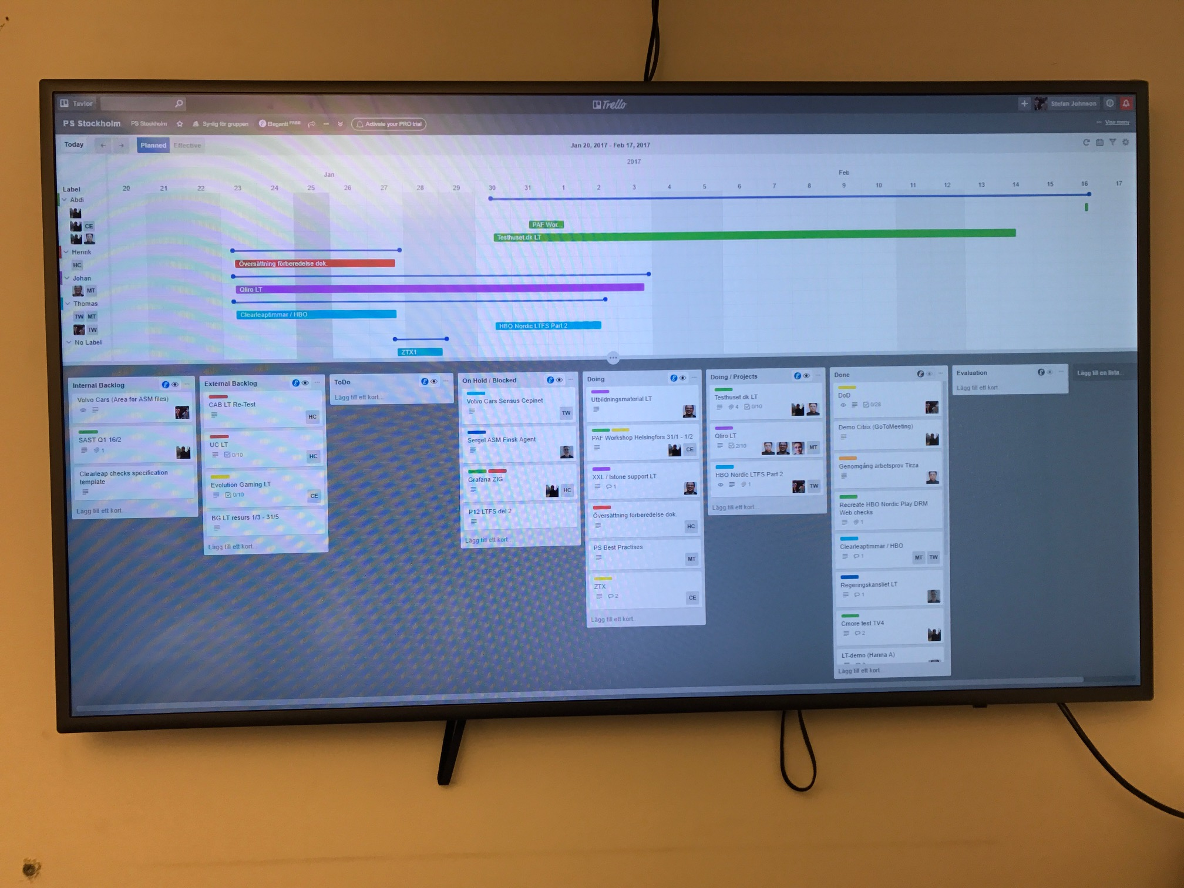
PS - Best practises
Best practises – ALT
Onboarding
Scripting
Load testing
Analysis & recommendations
Reporting
Project exit / Post mortem
Integrations (APM, CI)
Best practises - ASM
Onboarding
Scripting
Analysis & Reporting
Integrations (APM, CDN)
Confluence link…

Slide 15
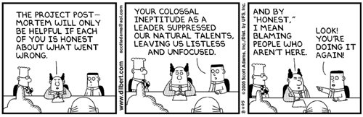
PS - Best practises – Post mortem…
Backup of project data
LT scripts, LT reports, customer specific data (to LTP)
Project evaluation (external customer)
Handled by Apica test lead
Project retrospect (internal Apica)
Participants
Project test lead
Performance Engineer/s
Opportunities
Risks
Food for thoughs
Assets
Feedback to Sales
Opportunities & risks

Slide 16
PS – Support tools - Activity board
Trello board
Kanban board of customer activites implemented in Trello. Daily Stand up meetings.

Slide 17
PS – Support tools - Calendar overview
PS calendar overview
Weekly calendar view of assigned activities implemented in Smartsheet.

Slide 18
PS – Support tools - Project overview
PS project overview
PS Project overview implemented in Smartsheet..

Slide 19
PS – Support tools - Time management
QBIS
PS time management tool – QBIS. Weekly time reporting, follow up on customer engagements etc.

Slide 20


PS – Partners (DevOps & QA partners)
A separate sales and delivery channel from Apica’s own team
Strategy
Identify
Establish
Enable
Sales enablement
Delivery enablement
Co-market
Co-brand
PS plays an important role enabling DevOps & QA partners
QA partners in the Nordics
SopraSteria (NO), Sogeti (SE), Know IT (SE), Testhuset (DK)

Slide 21

PS - Focus areas in 2017
Global…
PS organisation
Best practises (i.e. Apica delivery methodology™)
Rotation program (between Sweden & US)
Service catalogue
Resource management
Competence plan
Internal processes
Reporting (metrices & KPIs)
Delivery partners

Slide 22
PS - Our offerings – How we work
Agile Methodology
Collaboration
We design and implement functionality in tight collaboration with our customers and partners.
Deploy & Operate
We offer Managed Services to operate/maintain the customized solutions and the underlying platform of our customer.
We use Agile methodologies to manage our projects.
We use the tools & methodologies preferred by our customers.
The design of a new feature and/or solution often starts through a set of workshops.

Slide 23

PS - Service offerings - Performance Excellence
Apica
Web Performance
Experts
Apica is a true specialist within Web Performance.
We have developed a word class platform for Load Testing (ALT) and Synthetic Monitoring (ASM) which is successfully used by a large number of customers.
Current
Service
Offerings
We deliver load test engagements and synthetic monitoring scripting support to our customers.
The services are often tightly coupled to our products and are relatively short in duration.
Extended
Service
Offerings
We have now extended our Apica Service Offerings to advisory and best practises level in order to support our customers with Performance Excellence topics.
The Extended Service Offerings are less tightly coupled to our products and instead more focused on customer value in the Web Performance disciplines.

Slide 24
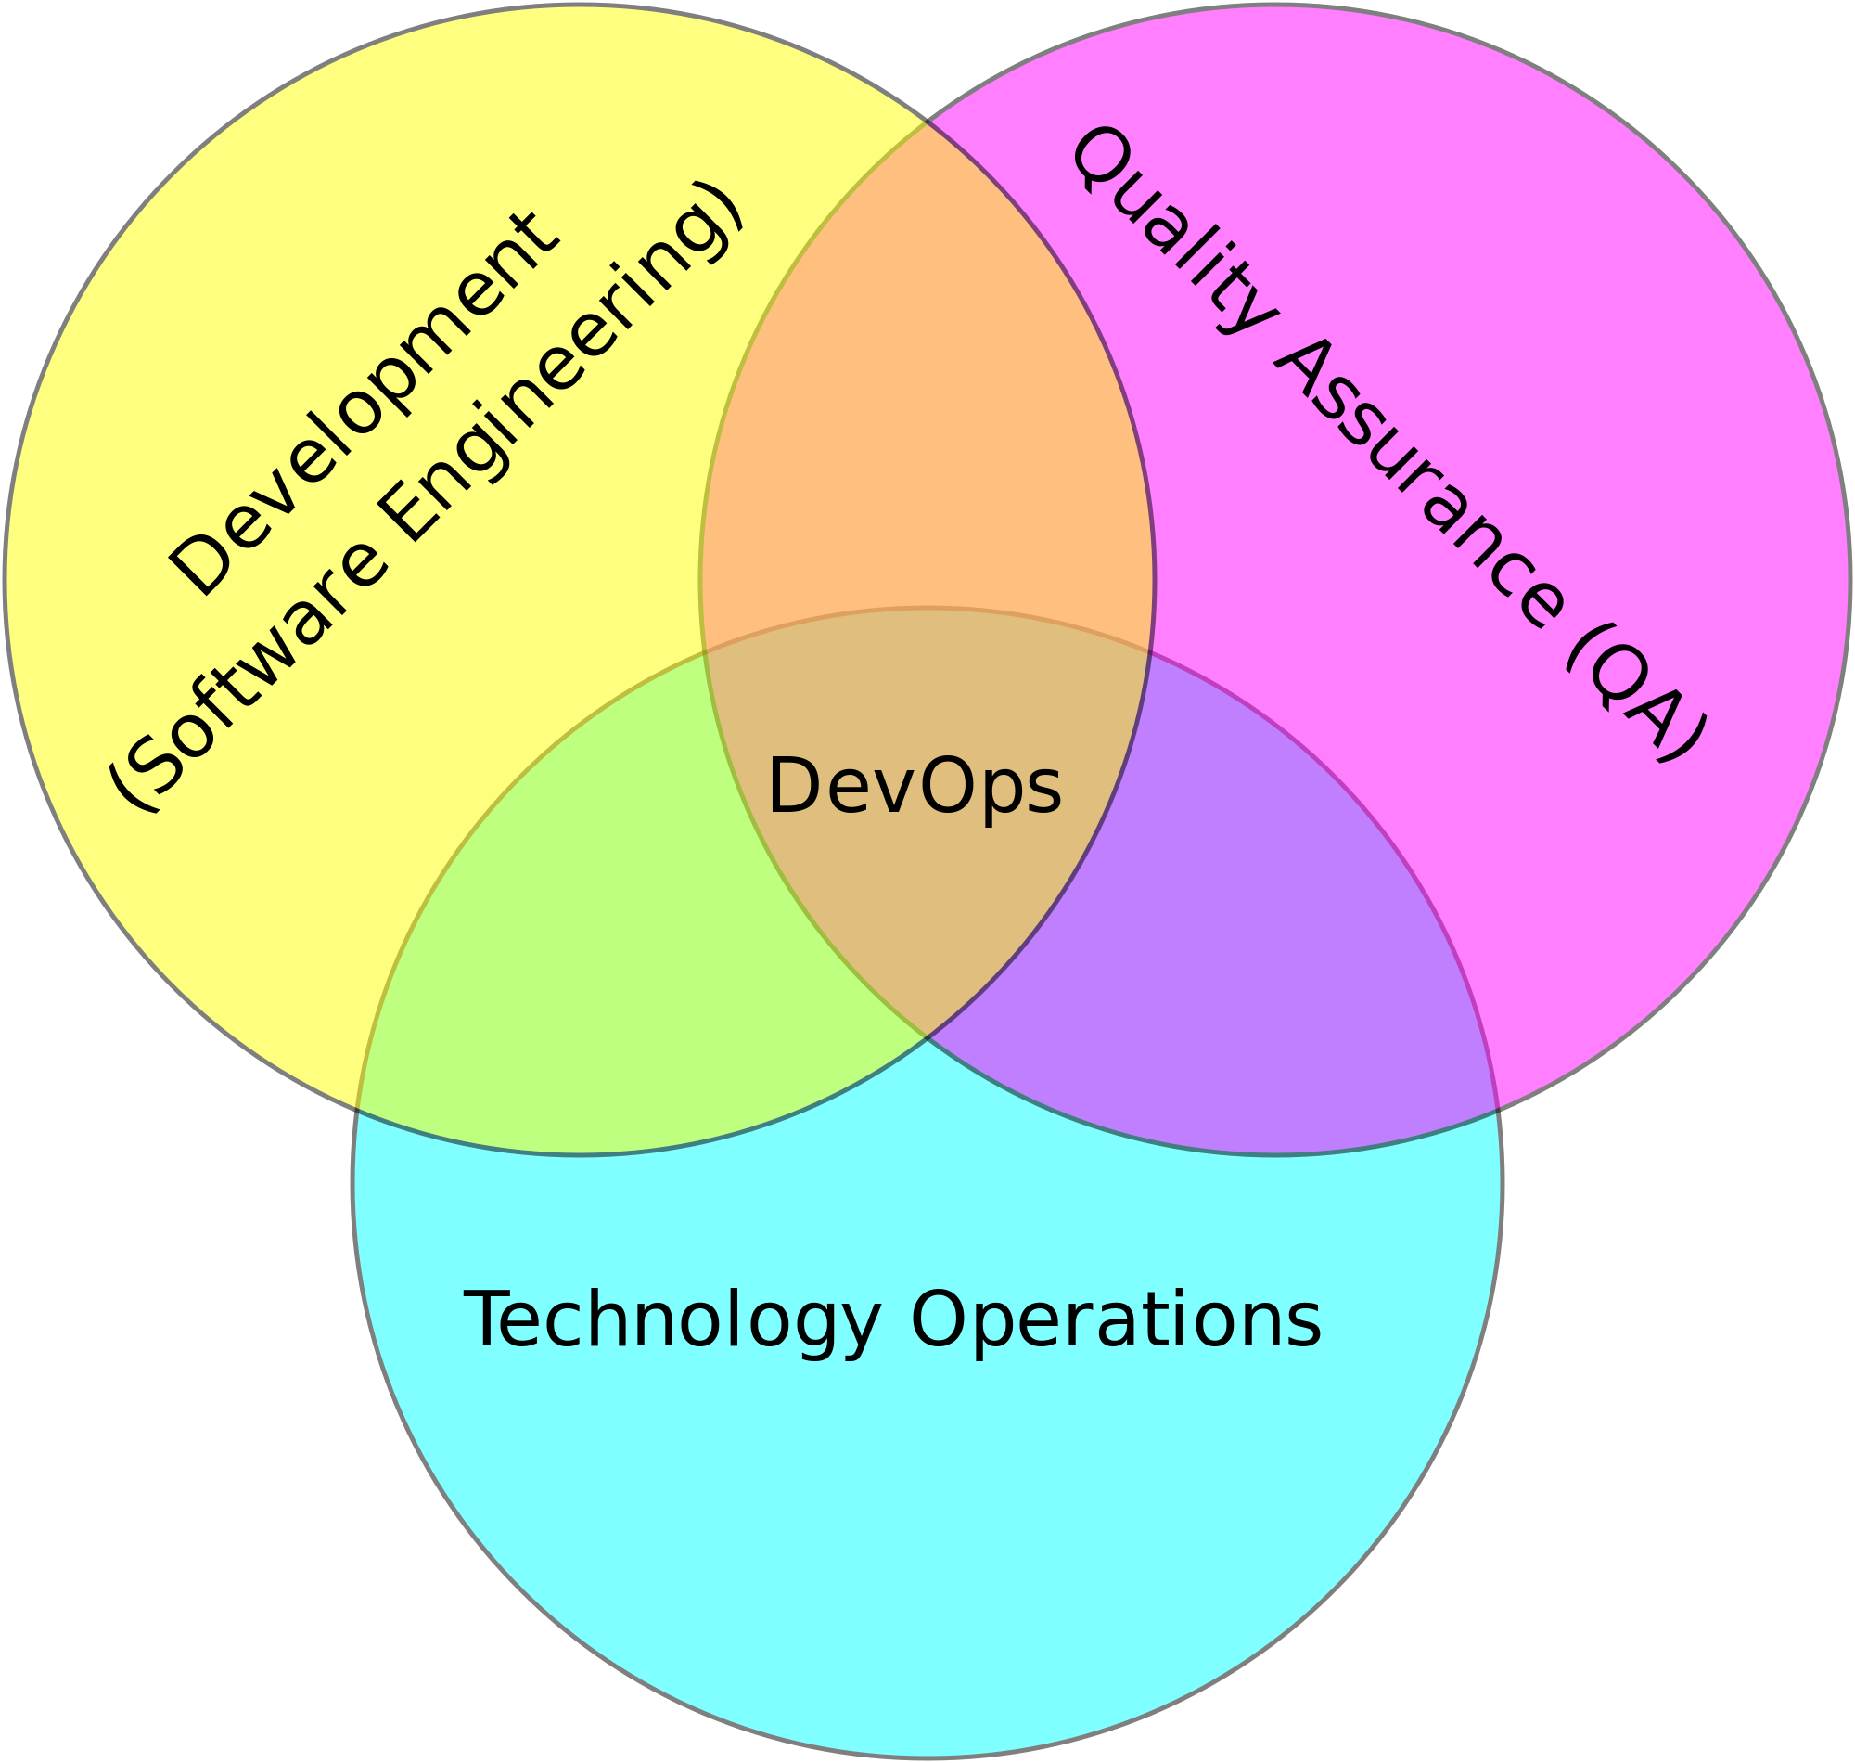

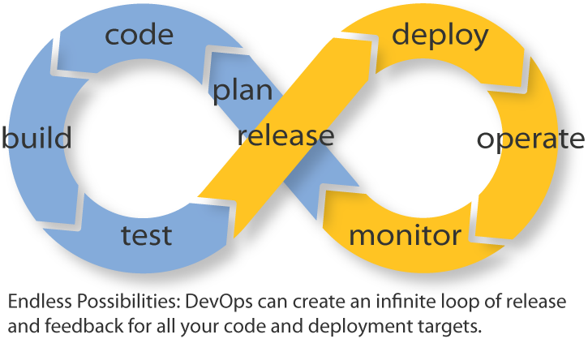
PS – Load testing in Continuous Integration
Topic description
Continuous Integration and Testing are parts of Agile development and DevOps disciplines.
Load testing in this context means that it is integrated in the continuous build & release management processes of applications.
Apica product capabilities
The Apica Load testing product suite is ready to manage continuous integration.
We integrate our tools with the leading solutions in this area.
Service deliveries
We help you to develop and maintain load test scenarios which works in your test environment for continuous delivery/testing.
We help you with setting up integration between Apica load test management platform and your tools & processes in continuous integration.
You can automate execution of load tests with the automation API in our load test management platform.

Slide 25
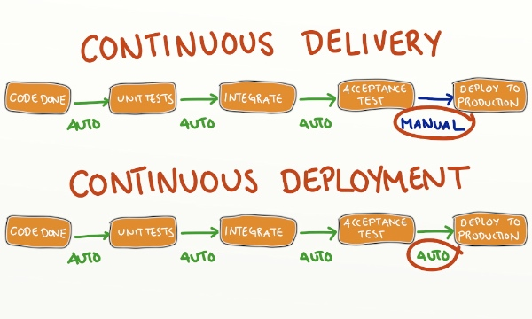

PS – Environment management in SDLC
Topic description
With Agile development and continues delivery the demand for various types of run-time environments is critical.
Reliable and efficient procedures for provisioning of environments for development, testing, pre-production is needed
Apica
Service Overview
Using your preferred toolset and implement optimal level of automation
Examples of deliveries
Automated provisioning of test environment
Automated test data management for functional and load testing purpose. Synthentical data generation and anonymization of production data.
Virtualization of depended external services. Aka Service Mockups or Service Virtualization
Setting up run-time environments for development and testing including infrastructure, OS layer, software, applications with valid test data.

Slide 26

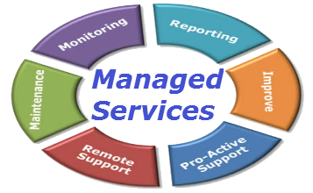
PS – APM Managed Services
Topic description
Application Performance Management (APM) products are very popular for management of modern web and mobile application
Monitors the applications from a business transaction perspective and with strong capabilities for root-cause analysis.
The APM problem area
The challenge is the need of an owner and a team which supports the stakeholder who will benefit from the value of the APM solution.
Service offering
Optimize the value of the APM investment with a Managed Services approach for APM.
We operate and further develops the APM solution and its value including on-going operations, deployment, report creation, alert management, dashboard creation etcetera.
The main stakeholders are application owners, operations, development and test.

Slide 27

PS - Performance Center of Excellence
Test Design & NFRs
Scripting & QA
Testing
Optimization
Re-testing
Analysis, Reporting & Recommendations
Post-actions & Automation
#6
AUTOMATION /
CONTINUOUS DELIVERY
#1
TEST STRATEGY:
Core Team
Toolset
Processes
#
Organization
Infrastructure
#
#
#
#
#2
#5
DELIVERY ASSURANCE
Steering & Governance
#
Service / Platform Owner
#
#4
CORE TEAM
Performance Engineer & Test Lead
PROJECT #2
PROJECT #2
PROJECT #2
Infrastructure / Operations
#3
Performance Delivery Team
Release Management

Slide 28
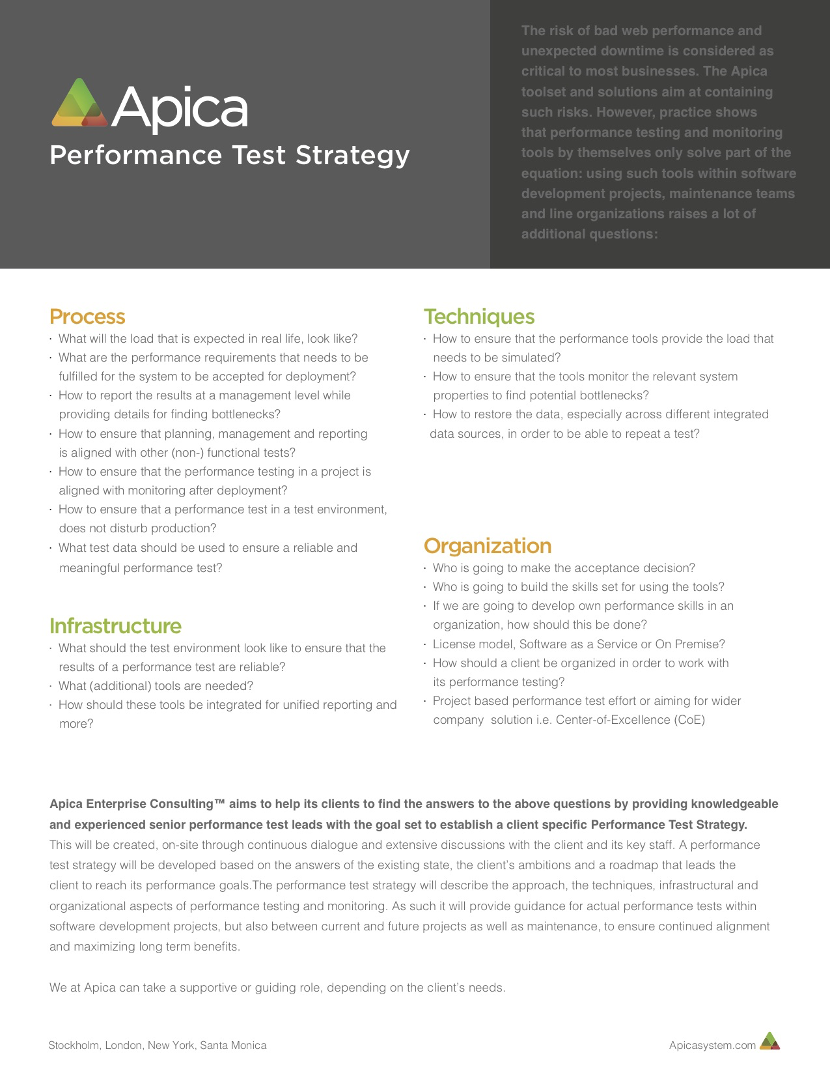
PS – Performance Test
Strategy
Apica – Services

Slide 29
Apica
Professional Services
Patrick Moser
Email: patrick.moser@apicasystem.com
Mobile: +46-730-255077

